Slide 1

AGILE DEVELOPMENT

Slide 2
Agile Roles Explanation
Product Owner
Maximize the value of the product
Maximize the work of the Development Team
Scrum Master
Provides guidance on Agile Methodology Principles by mentoring the team when needed
Is a servant-leader for the development team and the product owner
Is a facilitator for Scrum Events
Development Team
Consists of, but are not limited to: Developers and Testers
Is Self-Organized
Is a cross-functional team
Notes:
These are just a few note worthy aspects of each role and how they apply to the Scrum Team.

Slide 3
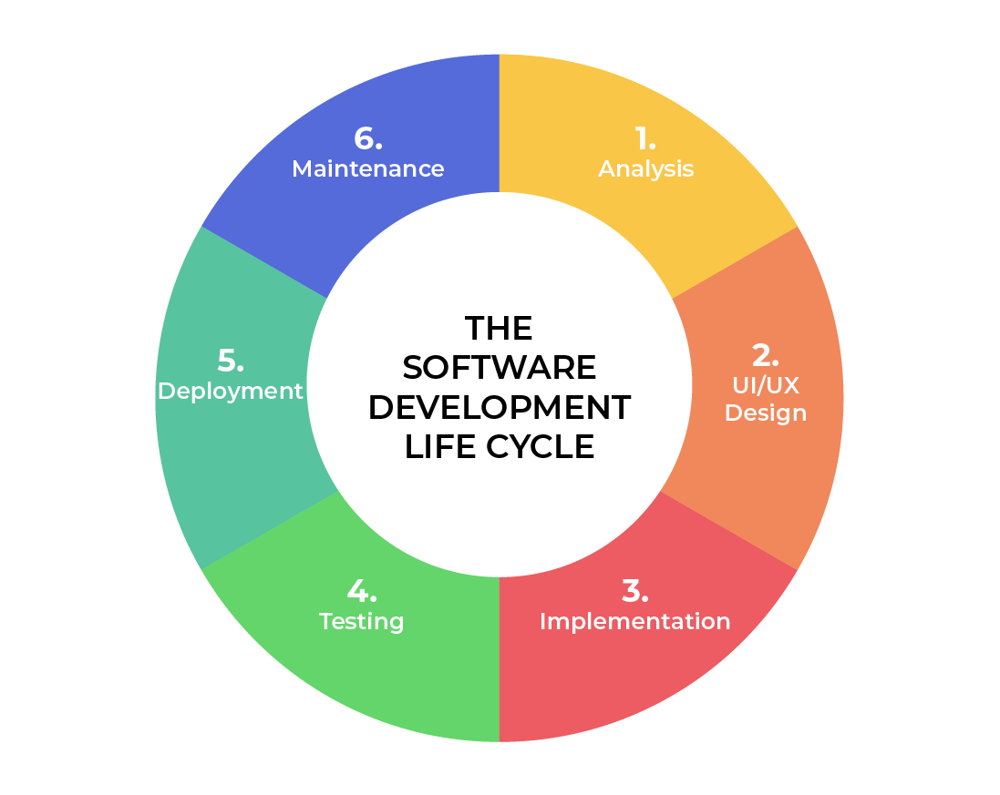
Software Development Lifecycle
1. Analysis
Collaborates with stakeholders and clients directly.
Gathers information and requirements for user needs.
2. Design
Defines lists of detailed processes for functionality that fits user needs
Defines factors such as time limits, budget, and other limitations.
3. Implementation
Development is broken down into smaller chunks of functionality
4. Testing
Is the process of identifying and reporting any bugs, defects, or imperfections found within a codebase.
5. Deployment
All testing and development is complete, and the product is ready to be pushed into a production stage for the publics use.
6. Maintenance
Developers focus on fixing bugs and implementing new features as time goes on.

Slide 4
Waterfall Methodology
The waterfall approach differs majorly from an agile approach. The primary way these two differ is primarily in the flexibility of change happening within a project. While Agile focuses more on flexibility throughout the project, allowing for continuous movement through the phases during development, waterfall requires each phase to be complete 100% before moving on to the next phase. Also, all requirements must be stated upfront in a waterfall approach, leaving out any uncertainty that may arise in the project. In the SNHU Travel Project, had we gone with a waterfall approach, all requirements and scope would have to be know with a very high level of certainty at the beginning before moving forward through the lifecycle. This approach would have limited the flexibility of adding changes later and would have limited the creativity of the team that was provided through the agile approach.

Slide 5
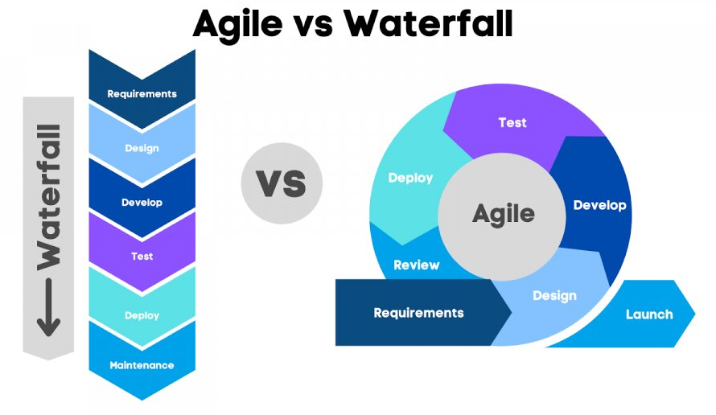
Waterfall:
All requirements and the scope must be heavily detailed and defined.
Uses sequential stages that are dependent on the previous stage's completion.
Is best utilized for more simple and unchanging projects.
Agile:
Does not require the definition of all requirements.
Broader description of a requirement, with the functionality evolving over time.
No time constraints for production
Notes:
These are just a few aspects that stick out about these two methodologies.

Slide 6
References
Atlassian. (2024). Waterfall Methodology for Project Management. Atlassian.
https://www.atlassian.com/agile/project-management/waterfall-methodology#:~:text=What%20is%20the%20Waterfall%20methodology
Cobb, C. G. (2015). The project manager’s guide to mastering agile : principles and practices
for an adaptive approach. John Wiley. https://ebookcentral.proquest.com/lib/think/reader.action?docID=1895876&ppg=131
DATAVALLEY.AI. (2023, January 31). Waterfall Vs Agile: Which is better for You and Why?
Www.linkedin.com. https://www.linkedin.com/pulse/waterfall-vs-agile-which-better-you-why-datacademy-cloud/
Harris, R. (2021, May 20). Software Development Life Cycle (SDLC). Www.linkedin.com.
https://www.linkedin.com/pulse/software-development-life-cycle-sdlc-tutorial-richard-harris/

